Slide 1
SMART HOME SYSTEM
TuringJunior

Slide 2



PROBLEM
TODAY
Our homes are equipped with electronics appliances
Difficulties copping with these devices
Difficult to be aware of our home security and statistical state.

Slide 3


SOLUTION
control them remotely
Real time notification
Device synchronizations
Just go, don’t worry

Slide 4


SMART HOME SYSTEM
Our product is your solution
Security is our priority
Make everything prepared before you back
Control everything within your fingertips

Slide 5







OUR SYSTEM IS MODULUS
EACH SMART DEVICES ARE INDEPENDENT FROM EACH OTHER
Application
Control Hub
Smart Devices
control the smart devices on smart phone
Connect all smart devices

Slide 6


Why our system is great in security

Slide 7
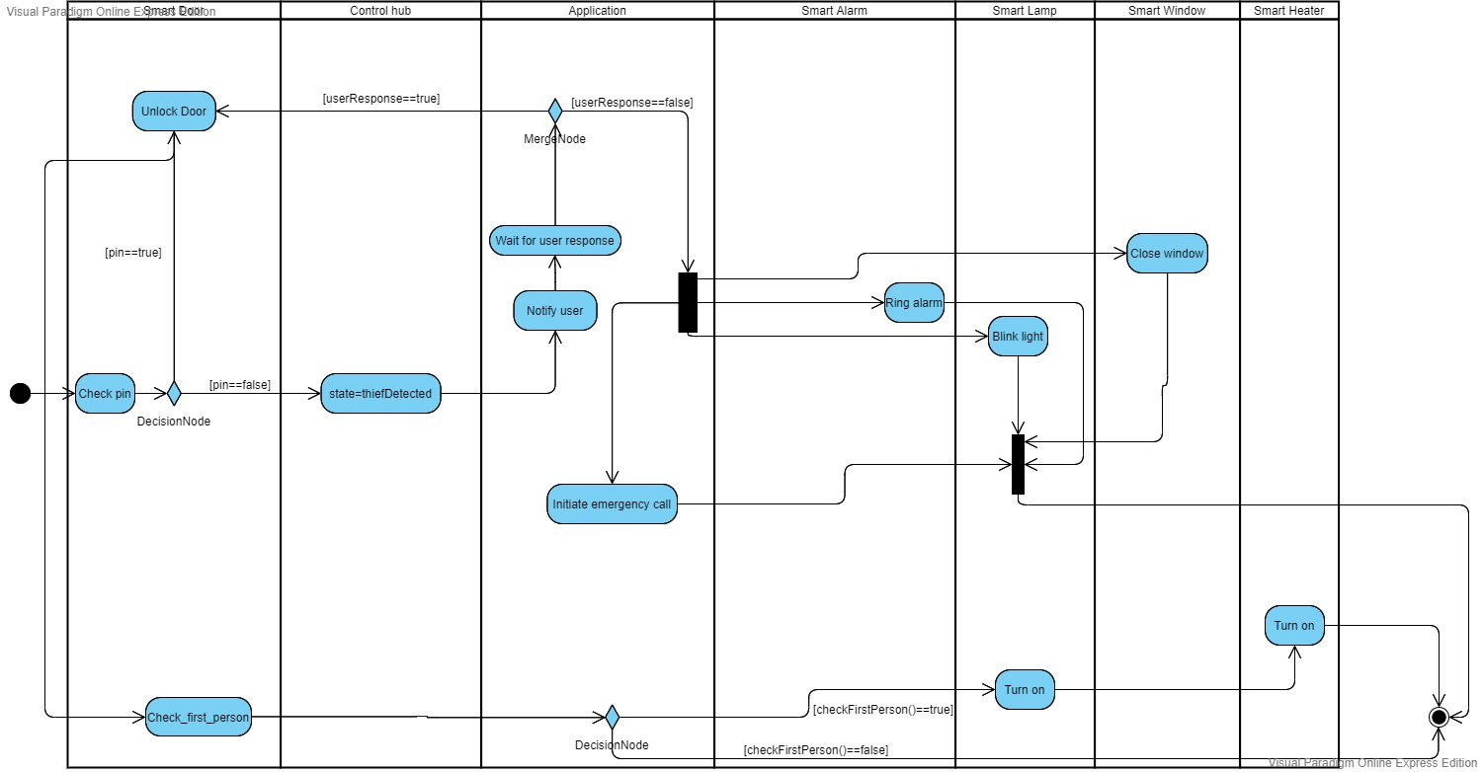

Slide 8
CONTROL HUB THE MIND OF OUR SYSTEM

Slide 9
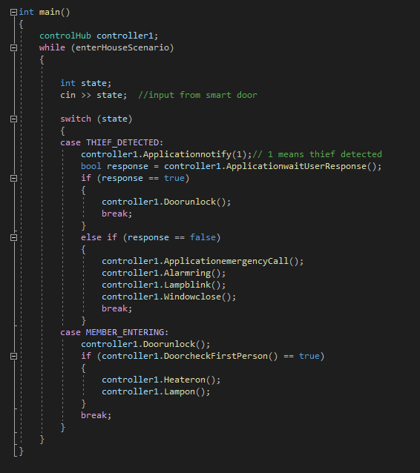
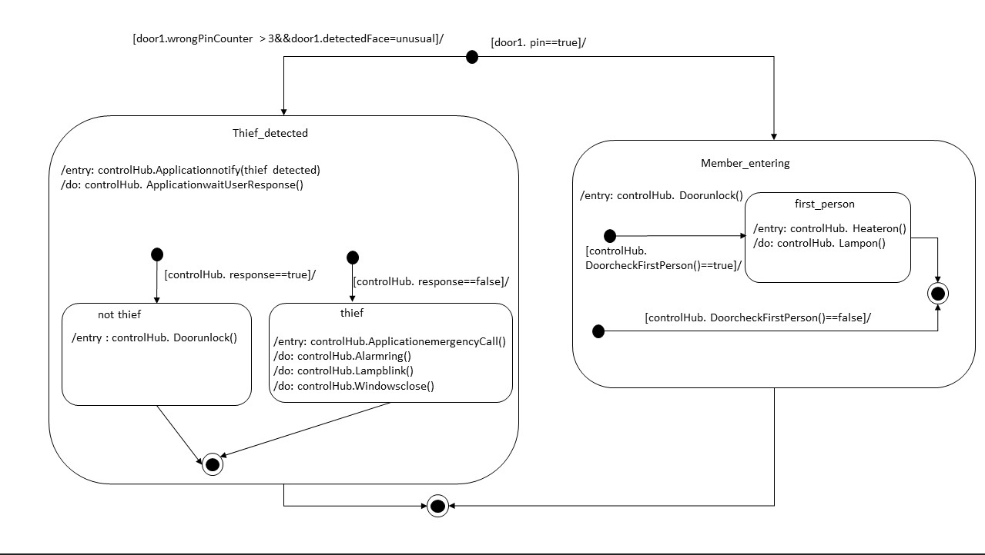

Slide 10
OUR SMART DEVICES ARE SPECIAL

Slide 11
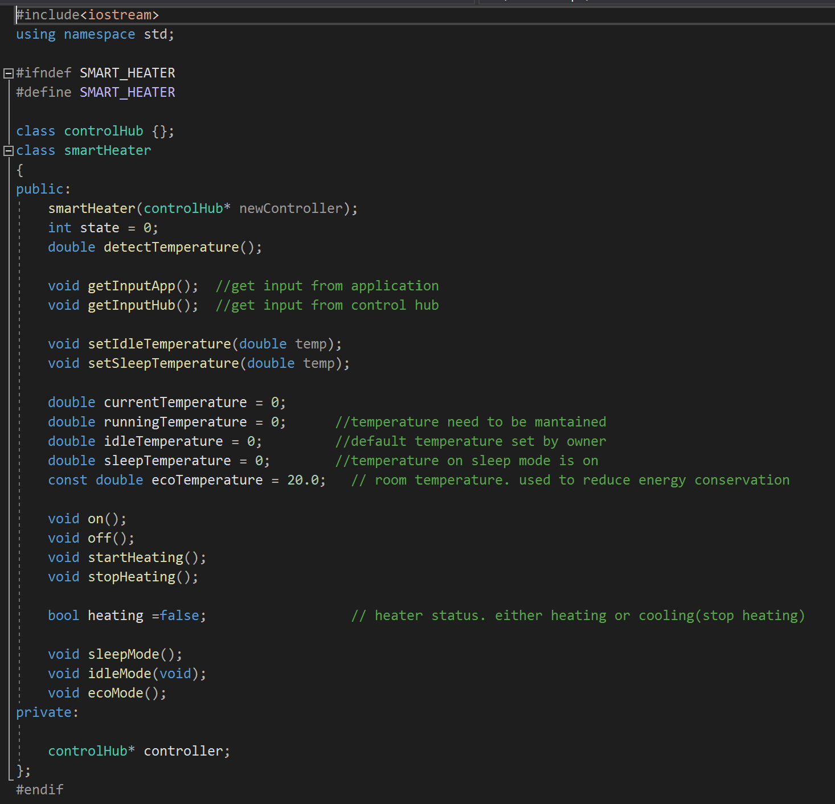
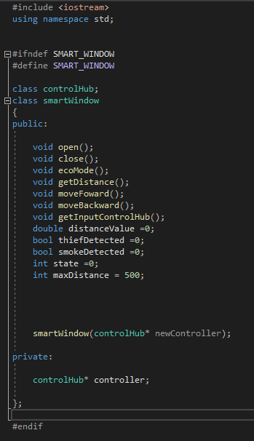
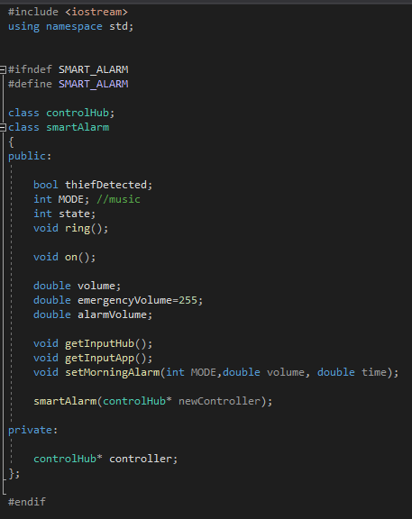
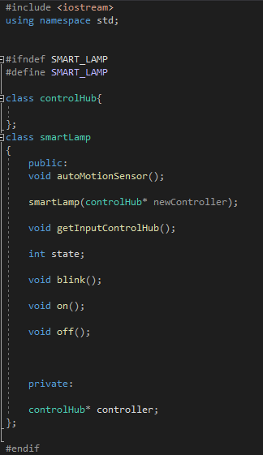
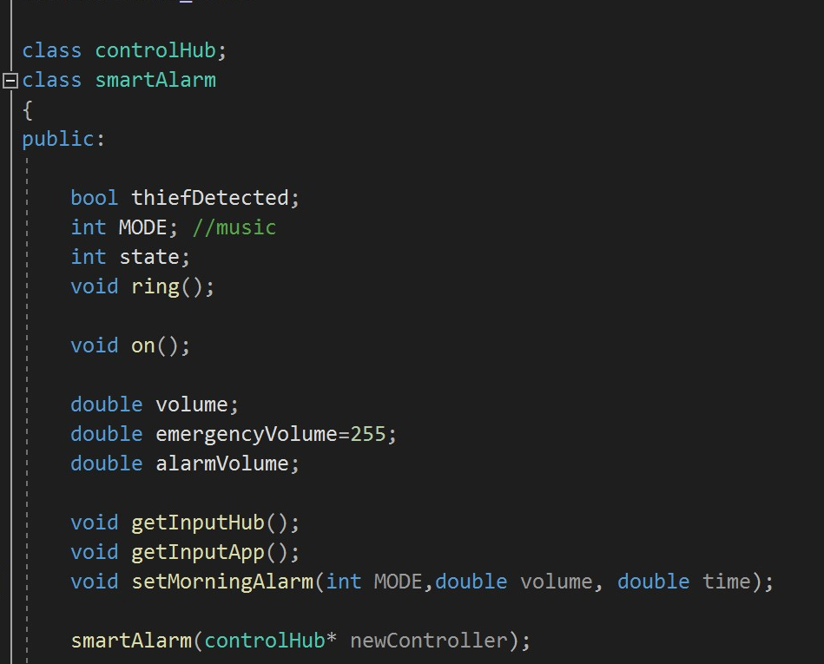
Smart heater
Optimise for sleeping
Smart window
Solar panel
Reduce electricity cost
Smart alarm
Wake up on time
Smart lamp
Lighten your way

Slide 12
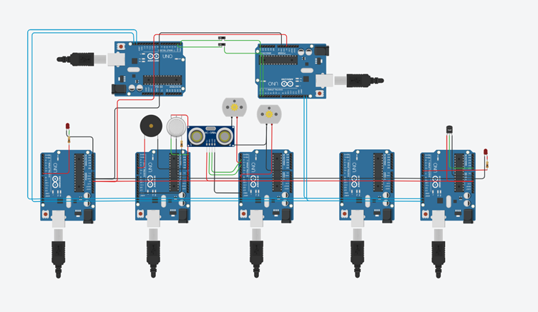
Overview
Application
Control Hub
Smart Lamp
Smart Alarm
Smart Window
Smart door
Smart Heater

Slide 13
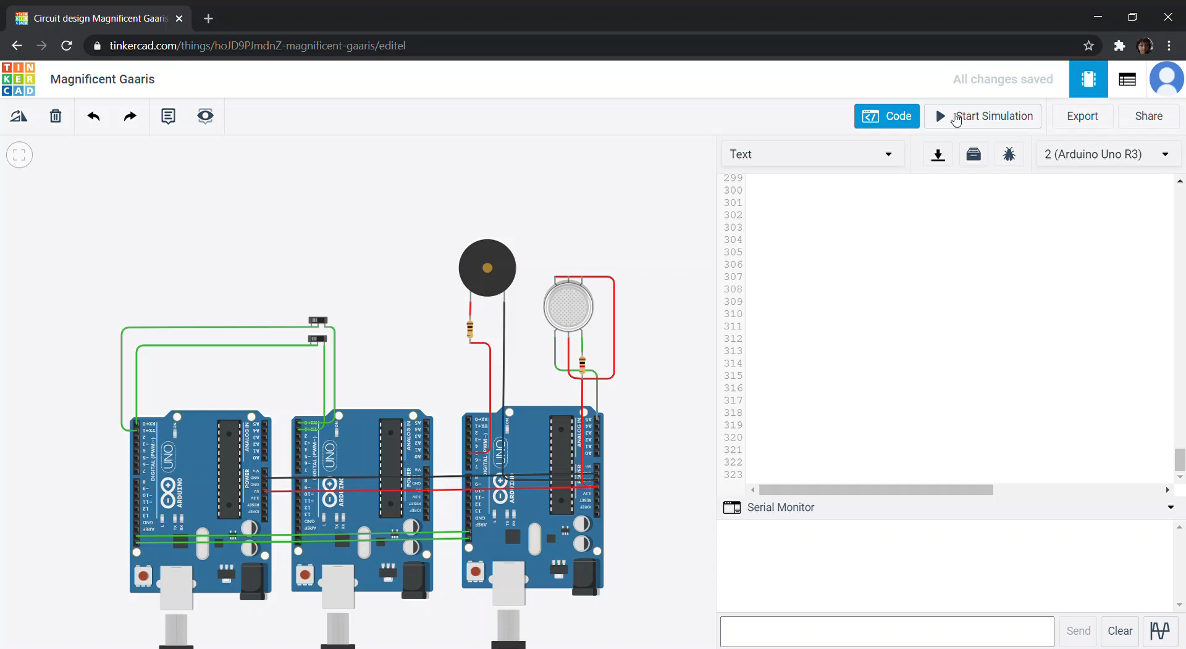
SIMULATION
Application Screen
Application
Control Hub
Smart Alarm
User Input

Slide 14

THANK YOU!
TuringJunior
Phone:
+49-678-555-0134
Email:
turingJunior@team.com
Website:
http://www.turingJunior.smartHome/

Slide 15





OUR TEAM
Always be your solution
Zafirul
Sheikh
Ammar
Developer
Developer
Developer
Hadi
Evrard
Developer
Developer

